Slide 1

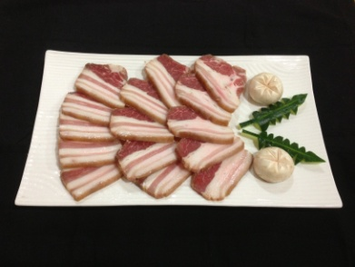
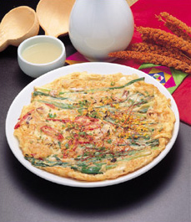
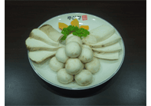
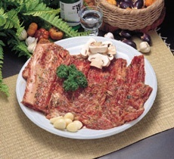
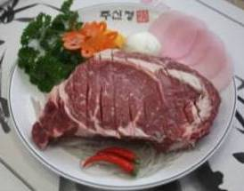
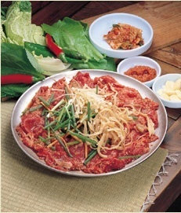
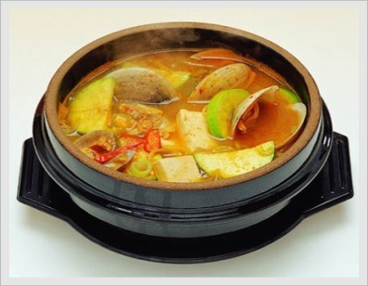
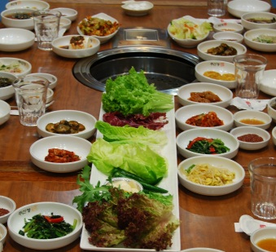
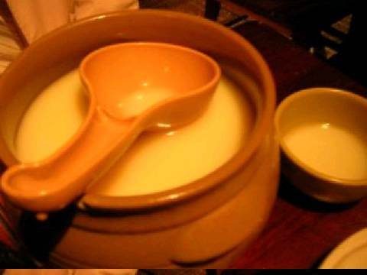
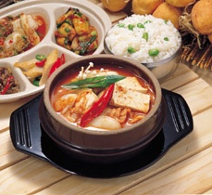
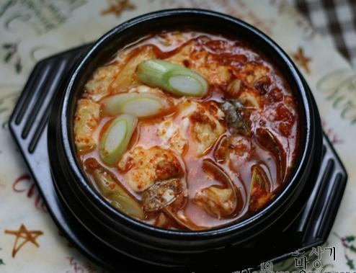
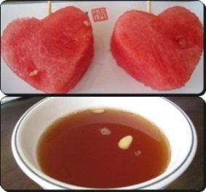
Special Family set
2~3 Person Set S$ 129
3~4 Person Set S$ 149
Smoked pork belly
Mushroom
Seafood pancake
Smoked pork belly
Mushroom
＋
One choice from three items
Marinated Beef Rib
or
Black Angus Sirloin
or
Seasoned Slice Beef
＋
Choose one
Soup
＋
Korean rice Wine
(Rice wine for Today)
Kimchi Big or Seafood Tofu
or Seafood Soya bean Soup
*Price subject to 10% service charge and prevailing G.S.T.
*This set menu excludes: Wet Towels, Tea and Water

Slide 2
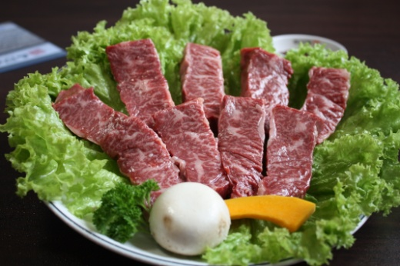
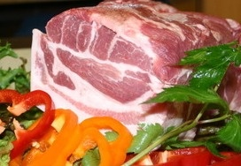
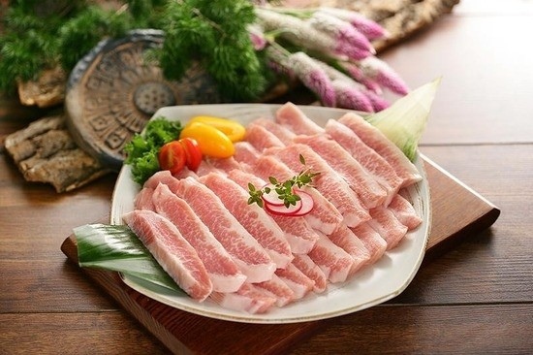
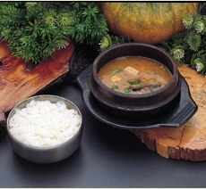

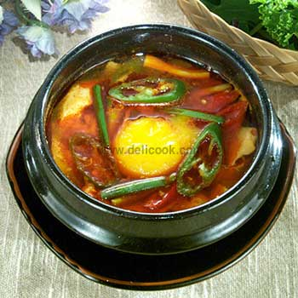
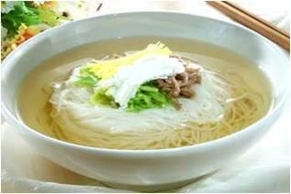
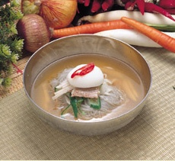
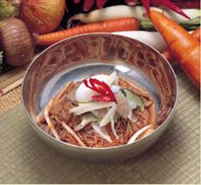

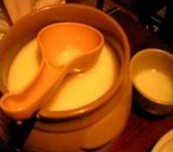

Meat Combo Delight set
One BBQ item
(Minimum 2 set)
BEEF set S$ 86++ PORK set S$ 68++
YANGNYUM or ANCHANG BLACK MOKSAL or HANGJUNG
( Marinated beef rib) (Wagyu Beef Skirt) (Premium Black Pork Collar) (Pork Jowl)
+
One choice from six items (Soup comes with a rice)
DAENJANG
Soya Bean Paste Soup
KIMCHI
Spicy Kimchi Soup
SOONDOBU
Spicy Tofu Soup
somyun
Clear Soup Noodle
mulnaeng
Chilled Noodle soup
BINAENG
Spicy Mixed Noodle
+
Free item with set menu
Vegetable Side Dishes and Appetizer Rice Wine of today Watermelon and Dessert Tea
*Price subject to 10% service charge and prevailing G.S.T.
*This set menu excludes: Wet Towels, Tea and Water

Slide 3
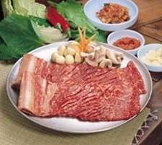
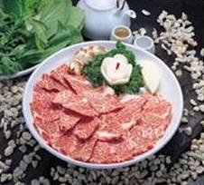
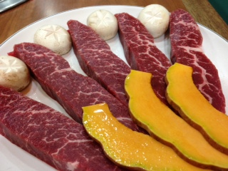
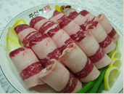
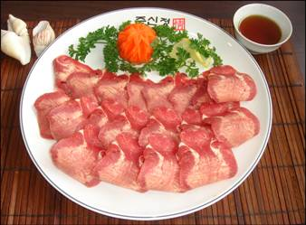
BEEF MENU
Minimum 2 order for grill
(Except C20)
*STA=Subject to availability
STA
Must try
Must try
C1.왕갈비 (WANG) S$59
(Black Angus Beef-Rib: 350g)
C2.양념갈비(YANGNYUM) S$49
(Marinated Beef-Rib: 350g)
C3.꽃살 (GGOTSAL) S$59
(Wagyu Beef Chuck-Rib:130g)
Must try
C4.안창살(ANCHANG) S$53
(Wagyu Beef Skirt: 160g)
C5.갈비살(GALBISAL) S$35
(Short-rib Boneless: 160g)
C6.생등심(DEUNGSIM) S$49
(Black Angus Sirloin: 160g)
C7.차돌박이(CHADOL) S$35
(Wagyu Sliced Beef: 130g)
C8.우설(WOOSUL) S$35
(Sliced Beef Tongue: 130g)
C9.불고기(BULGOGI) S$50
(Seasoned Slice Beef: 300g)
Pictures shown may vary from actual product

Slide 4


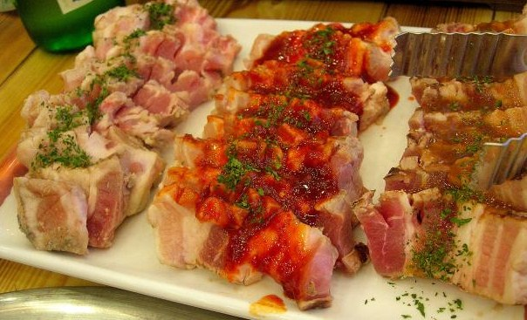
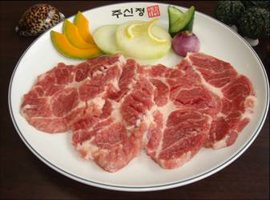
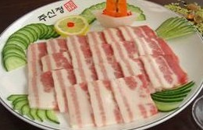
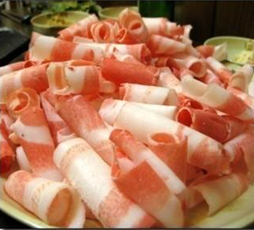
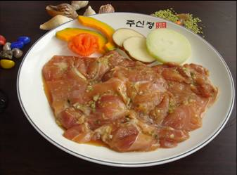
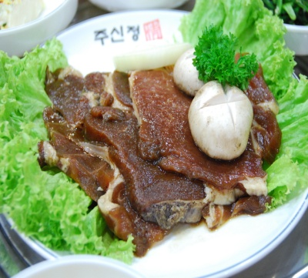
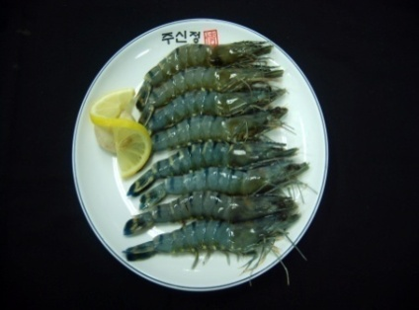
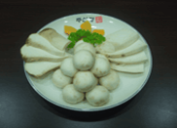
PORK MENU
Minimum 2 order for grill
(Except C20)
*STA=Subject to availability
Must try
Must try
Must try
C10. 훈제삼겹(HUNJAE) S$35
(Smoked pork belly: 250g)
C11. 흑목살(MOKSAL) S$35
(Black Pork Collar: 200g )
C12. 항정살(HANGJUNG) S$35
(Pork Jowl: 200g )
C13. 벌집삼겹살(BEOLJIP) S$28
(Honeycomb Pork Belly:200g)
- One Flavor Per Serving
Herb, Chili or Sweet
C14.목살(MOKSAL) S$22
(Pork Collar: 200g)
C15.삼겹살(SAMGYUB) S$22
(Pork Belly: 200g)
C16. 대패삼겹(DAEPAE) S$22
(Thin Slice Pork Belly: 200g)
C17.양념돼지(DAEJI) S$22
(Marinated Pork: 200g)
C18.닭불고기(DAK) S$22
(Marinated Chicken: 200g)
C19.왕새우(SAEWOO) S$30
(Fresh Tiger Prawn) 8pcs
C20.모듬 버섯(BOSOT) S$10
(Mushrooms: 100g)
Pictures shown may vary from actual product

Slide 5

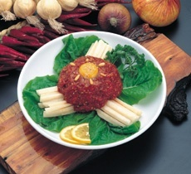
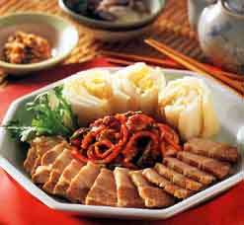
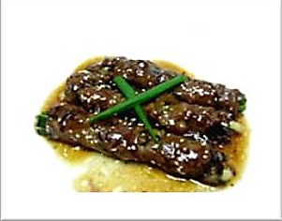
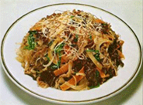
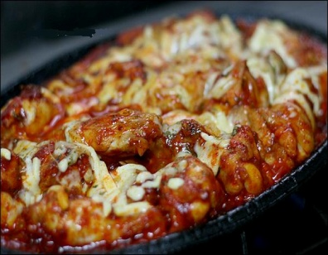
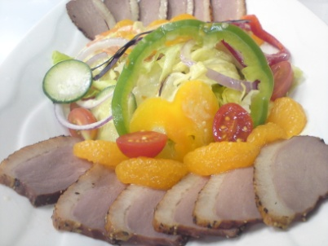
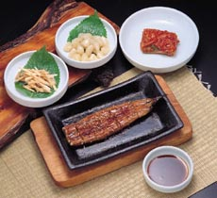
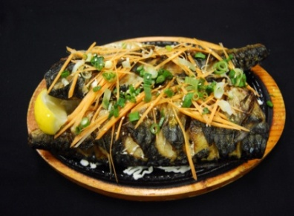
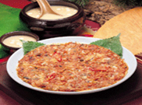
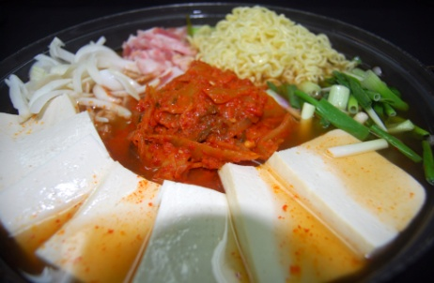
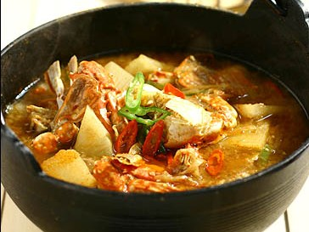
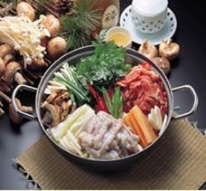
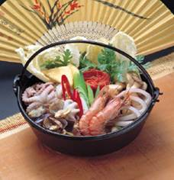
A1.육회(YUKHAE) S$30
(Seasoned Raw Beef)
A2.보쌈(BOSSAM) S$30
(Steamed Pork & Special Kimchi)
A3. 소고기 파말이(PAMALY) S$20
(Beef Roll with Spring Onion )
A4.잡채(JAPCHAE) S$25
(Fried Noodle with Beef)
A5. 불닭(BULDAK) S$35
(Spicy Chicken With Rice Cake)
A6. 훈제오리샐러드(Ori salad) S$15
(Smoked Duck Salad)
A7.장어구이(JANG O) S$20
(Grilled Eel)
A8.고등어(JABAN) S$15
(Deep Fried Saba Fish)
A9.해물파전(PAJUN) S$20
(Seafood &
Green Onion Pancake)
A10.김치전(KIMCHIJUN) S$20
(Kimchi Pancake)
전골(HOT POT)
J1.김치전골(KIMCHI) S$50
(Kimchi Soup with Noodle)
J2.된장전골(DAENJANG) S$50
(Soya Bean Paste Hot Pot)
J3.해물전골(HAEMUL) S$50
(Spicy Seafood Hot Pot)
J4.불낙전골(BULNAK) S$50
(Beef Bulgogi & Octopus)
* Additional charges : Bossam Kimchi S$10(A2), Dry Seaweed S$2(A6), Plain Noodle S$2(J1)
* Side dishes in pictures are not necessarily be the same when served.
* Side dish charges : S$1 for round plate, S$2 for oval plate side dishes (The first set is FREE)

Slide 6
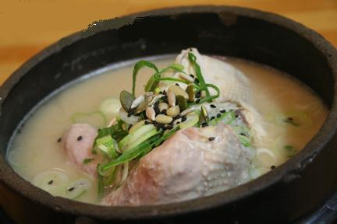
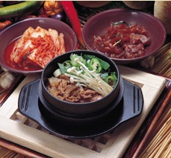
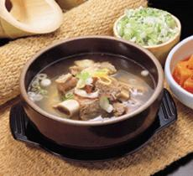







S1.삼계탕(SAMGETANG) S$23
(Korean Ginseng Chicken Soup)
S2.뚝불고기(DDUKBUL) S$16
(Beef in a Pot)
S3.갈비탕(GALBITANG)S$15
(Clear Beef-rib Soup)
S4.육개장(YUKGAEJANG) S$15
(Spicy Beef Soup)
S5.닭개장(DAKGAEJANG) S$15
(Spicy Chicken Soup)
S6.홍합탕(HONGHABTANG)S$25
(Clear Mussel Soup)
S7.김치찌개(KIMCHI) S$12
(Kimchi Soup) Big S$14
S8.계란탕(GAERANTANG) S$10
(Boiled Egg)
S9.된장찌개(DAENJANG) S$12
(Soya Bean Paste Soup)
S10. 해물된장찌개
(HAMULDAENJANG) S$16 (Seafood Soya Bean Paste Soup)
S11.순두부찌개
(SOONDUBU) S$12
(Spicy Soft Tofu Soup)
S12. 해물순두부찌개
(HAMULSOONDUBU) S$16 (Seafood Soft Tofu Soup)
S13.비빔밥(BIBIMBAB) S$13
(Mixed Vegetable Rice)
N1.잔치국수(SOMYUN) S$12
(Noodle with Clear Soup)
N2.물냉면(MULNAENG) S$12
(Chilled Noodle soup)
N3.비빔냉면(BINAENG) S$12
(Spicy Miixed Noodle)
S14.돌솥비빔밥(DOLSOT) S$14 (Mixed Veg.rice in Stone Pot)
*Additional charges : Rice S$2 (A soup comes with a rice except for S1,S8) Add noodle (N2,3) S$6
* Side dish charges : S$1 for round plate, S$2 for oval plate side dishes (The first set is FREE

Slide 7



Korean Traditional Wine 50% discount
(Including all Beers)
♧ Except on Public Holiday Eve & Public Holiday
한국 전통주 50% 할인*처음처럼,참이슬 제외
(맥주도 할인됩니다)
♧ 단, 공휴일 전날 그리고 공휴일은 제외합니다.
Happy
Tuesday
WEST
Happy
Wednesday
EAST
Happy
Thursday
GUILLEMARD

Slide 8






MUST TRY
生
Lactobacillus is 100 times more than YAKULT
You can drink the Makguli when it is in its most delicious taste
NEURINMAUL MAKGULI
FRESH
Made from newly harvested rice transported to
BAESANGMYUN
( The most famous brewery company in Korea)
BAESANGMYUN is the only company that can
manufacture the original and finest taste of
NEURINMUL Makguli that passed the hygiene
standard of Korea
- Tried & Tested in Taste with 6% Alcohol
$25
LIMITED EDITION
This MAKGULI has a life span of 30Days.
So grab the chance to taste the Number one,
Only fresh & the most delicious rice wine in Korea
I transported by AIRPLANE

Slide 9















한국 전통주와 과실주 Korean Ginseng & Fruit Wine
K1. 강장백세주
(GANGJANG)
Premium Herbal Wine
Alc 15% ,700mL, S$60
K2. 백세주 (BEKSEJU)
Herbal Wine
with Ginseng
Alc 13%, 375mL, S$25
K3. 산사춘 (SANSACHUN)
Mountain
Small Apple Wine
Alc 14%, 375mL, S$30
K4. 매취순 (MATCHSOON)
Korean Plum Wine
Alc 14%, 375mL, S$30
K5. 복분자주 (BOKBUNJA)
Black Raspberry Wine
Alc 15%, 375mL, S$30
K6. 빙탄복 (BING TAN BOK)
Fizzy Black Raspberry Wine
Alc 7%, 370ml, S$17
* Corkage charges : Wine S$10, Liquor S$15 per bottle
* Room charges : Weekdays S$25, Weekend S$35
* Tax charges : 10% service charge, 7% GST

Slide 10







한국 막걸리와 소주 Korean Rice Wine & Soju
K7. 막걸리 (MAKGULI)
Pure Rice Wine
Alc 7%, 720mL, S$20
K8. 신선막걸리 (Shinsun)
100% Rice Wine
Alc 7% ,750ml, S$20
K9. 순희막걸리 (Soonhee)
100% Rice Wine
Alc 7% ,750ml, S$18
K10. 복분자막걸리
(Bokbunja Makguli)
Black Raspberry Rice Wine
Alc 7%, 360ml, S$16
K11. 대포막걸리(DAEPO)
100% RICE WINE
Alc 7%, 425ml, S$15
K12. 소주 (SOJU)
Korean Distilled liquor
Alc 19%,360mL, S$20
Beer
Soft Drinks
B1. Tiger Draft Beer (Mug)
B2. Tiger Draft Beer (Jug)
B3. Tiger Draft Beer (Tower)
B4. Heineken (Bottle)
B5. Guinness (Can)
B6. Korean beer (Can)
S$ 8
S$ 26
S$ 75
S$ 8
S$10
S$ 8
D. Soft Drinks (Can) S$ 3
1. Coca-Cola 2. Coke Zero
3. Sprite 4. Ice lemon tea
5. Flavor soft drink
D6. Fresh Orange Juice (Cup) S$ 5
* Corkage charges : Wine S$10, Liquor S$15 per bottle
* Room charges : Weekdays S$25, Weekend S$35
* Tax charges : 10% service charge, 7% GST

Slide 11

Are you having Unlimited BBQ?
Don’t give up BBQ Beef!
4 types BBQ BEEF 50% discount per dish
갈비살(GALBISAL)
Short-rib Boneless
생등심(DEUNGSIM)
Black Angus Sirloin
양념갈비(YANGNYUM)
Marinated Beef Rib
안창살(ANCHANG)
Wagyu Beef Skirt
A portion is 160g, Tax charges : 10% service charge, 7% GST are excluded
For Dining-in only, No Take-away
Only available with Unlimited BBQ
Not available with another voucher or discount
Ju Shin Jung West
It’s a Deal or no Deal?!
Unlimited BBQ On MONDAY Lunch
1 adult FREE with 3 paying adults
Not available on Public Holiday
Wet towel, Water & Tea are excluded
For Dining-in only, No Take-away
Not available with another voucher, discount or promotion

Slide 12







Unlimited BBQ
불고기
Seasoned Slice Beef
삼겹살
Pork Belly
돼지 목살
Pork Collar
양념돼지
Marinated Pork
양념닭
Marinated Chicken
왕새우
Fresh Tiger Prawn
♠ Lunch - Adult S$29++ , Child (0.9m~1.2m) $16++
♠ Dinner - Adult S$35++ , Child (0.9m~1.2m) $19++
Available Dinner Unlimited BBQ on Monday to Thursday only
Not available Dinner Unlimited BBQ on Public Holiday Eve and Public Holiday
Wet towel, Water & Tea are excluded
S$20 per 100g for any leftover
For Dining-in only, No Take-away
Not available with another voucher or discount
고등어 구이
Fried Saba Fish
갈비탕
Clear Beef rib Soup
순두부찌개
Spicy Soft Tofu Soup
돌솥비빔밥
Hot Stone Bowl Rice
된장찌개
Soya Bean Paste Soup
물냉면 /비빔냉면
Soup /Spicy Cold Noodle
Available One dishes per person
Unlimited BBQ is served with assorted side-dishes and free dessert.

Slide 13










Lunch Special S$ 9.90
One person minimum order is One Dish
Must try
Spicy
L1.고등어정식 (Saba Set)
Fried Mackerel
L2.갈비탕 (Galbitang)
Clear Beef Rib Soup
L3.순두부찌개 (Soondubu)
Spicy Soft tofu Soup
Spicy
Spicy
L4. 된장찌개(Daenjang)
Soya Bean Paste Soup
L5.돌솥비빔밥 (Dolsot)
Mixed Veg. Rice in
Stone Bowl
L6.닭개장(Dakgaejang)
Spicy Chicken Soup
L7.육개장(Yukgaejang)
Spicy Beef Soup
Lunch Special S$ 12.90
Spicy
Spicy
L8. 뚝불고기
(Dduk bulgogi)
Beef in a Pot
L9. 돼지불고기
(Daeji bulgogi)
Pork in hot plate
L10. 닭불고기
(Dak bulgogi)
Chicken in hot plate

Slide 14


JU SHIN JUNG
KOREAN CHARCOAL BBQ RESTAURANT
www.jushinjung.com
WEST
27 West Coast Highway #01-18 Westway 1F
(Opposite Haw Par Villa) S117867
TEL : 6464-0872
EAST
1018 East Coast Parkway #02-01 S449877
TEL : 6447-9279
GUILLEMARD
102 Guillemard Road #01-01 S399719
TEL : 6440-7707
DAMOTORY
11 Unity Street #01-30/31 Robertson Walk
S237995 (Korean Wine House)
TEL : 6235-6787

